Slide 1
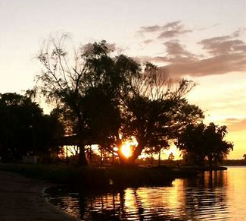
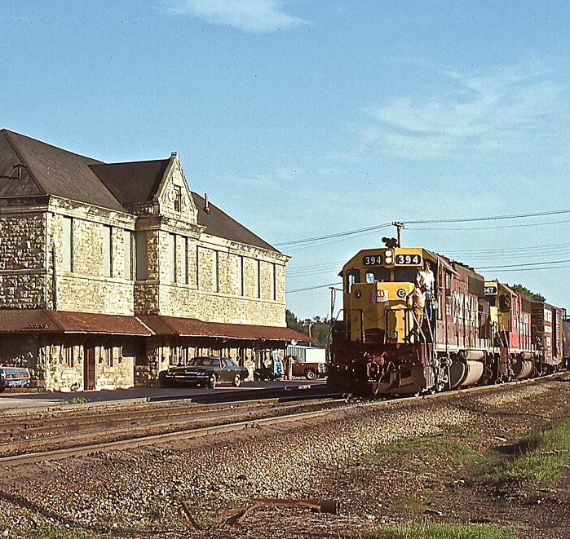
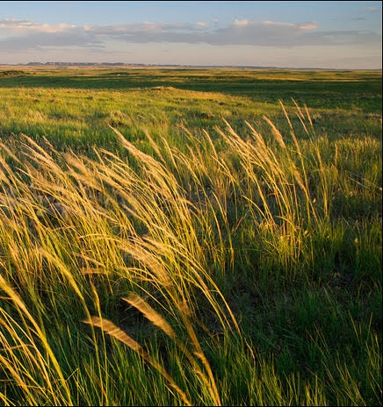
FLINT HILLS
REGIONAL COUNCIL
BOARD MEETING
Junction City Municipal Building
Junction City
July 21, 2023

Slide 2
AGENDA
1
2
3
4
5
6
7
CALL TO ORDER
WELCOME/ROLL CALL/QUORUM
APPROVAL OF MINUTES/FINANCIALS
NEW BUSINESS
OLD BUSINESS
COMMUNITY UPDATES
ADJORN

Slide 3
2
ROLL CALL
Clay County
Voting
1. Clay Center – James Thatcher
2. Wakefield – Julie Murphy
Dickinson County
Voting
1. Herington – Debi Urbanek
Geary County
Voting
1. Geary County – Trish Giordano
2. Junction City – Matthew Bea
Morris County
Voting
1. Council Grove – Sharon Haun
2. Morris County – David Fox
Non-Voting
White City – Susan McKenzie
Pottawatomie County
Voting
1. Pottawatomie County – Dee McKee
2. Wamego – Richard Weixelman
3. St. George – Deb Werth
4. Onaga – Alex Miller
5. Westmoreland – Bruce Meninger
Riley County
Voting
1. Manhattan – Linda Morse
Non-Voting
Ogden – Angela Schnee
Wabaunsee County
Voting
1. Alma – Pam Bales
2. Wabaunsee County – Jim MacGregor
3a. Alta Vista – Ryan Armbrust
3b. Eskridge – Terry Cook
3c. Harveyville – Teri Naylor
Quorum (6)
Ex-Officio
Non-Voting
Fort Riley
– Ben Van Becelaere
– Kelley Paskow
Gov. Military Council
– Perry Wiggins

Slide 4
3
MINUTES/FINANCIALS
Approval of June Minutes
Approval of May Financial Reports

Slide 5
3
ACCOUNTS
Bank Balance–Checking
$56,360.58
Money Market
Dues Rec’d. ($109,885.50)
$15,123.95
Kauffman Grant Account
& CDBG/NCRPC Funds
$179,421.00
Community Foundation
$21,397.57
CNB Loan Balance
$15,031.46

Slide 6
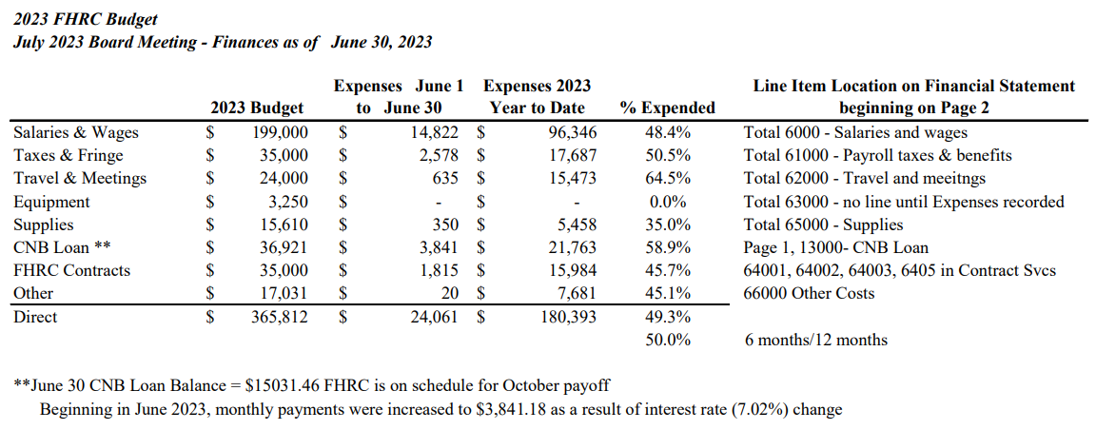
3
BUDGET

Slide 7
4
NEW BUSINESS
a. Build Kansas Fund
Matthew Hanson, CGMS
Build Kansas Fund is a matching fund appropriated by the Kansas legislature to remove financial barriers to participation with Bipartisan Infrastructure Law (BIL)
- Financial assistance to communities to meet match requirement
Direct training, technical assistance, and grant support for those entities pursuing BIL opportunities.
BIL and Kansas Hub description page in the July Meeting Board Packet.

Slide 8
4
NEW BUSINESS
b. KS Dept. of Commerce Grant Opportunity
Jerry Lonergan
Only Regional Development Organizations are eligible
$25,000 with 1:1 match (verifying EDA Partnership Planning can be used for match to create $50,000 program)
Submissions deadline – July 22
Proposal will focus on recreating the successful JC Entrepreneurship 101 program and deliver to the smaller member communities
First Task would be to convene the small communities to determine where and how many programs to target.
Vote to authorize moving forward on this effort

Slide 9
4
NEW BUSINESS
c. EDA Disaster Supplemental
Holly Boice
$57 Million across the EDA Denver Region – ten states
53 eligible counties in Kansas - most impacted in the Denver Region
Geary, Morris, Riley, Wabaunsee counties – windstorms and tornadoes in 2021 and 2022
FHRC counties’ population = 25% of the 53 counties total population
$5 million maximum ask - $1-2 million sweet spot
20% Match

Slide 10
4
NEW BUSINESS
Roadshow went well!
Summaries of potential projects have been sent to EDA to vet for eligibility
The application process is starting for projects with MATC, Manhattan Chamber of Commerce, and Kansas Forest Service.

Slide 11
4
NEW BUSINESS
d. FHRC Retreat – Sustainability to Action
Jerry Lonergan
Important discussion – we need all members to attend and participate – attendance restricted to members and alternates
Manhattan City Hall arrival 8:30 and working 9:00 to 1:00 (box lunch will be provided)
Defining how to best put into action the recommendations from the 5 Year Sustainability Plan – short term (next 3 months); midrange (4 to 10 months); and longer term.
Letter from facilitators in the board packet

Slide 12
5
OLD BUSINESS
a. EPA Brownfield Assessment Project Update
Janna Williams

Slide 13
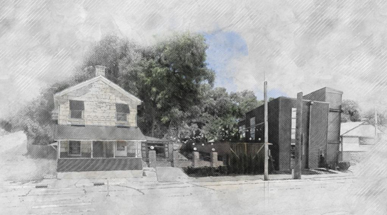
EPA Brownfield $500,000 Assessment Grant- Project Update
Ogden – 73,600/$119,100
Downtown Area Planning August Completion
Area Wide Plan (arcgis.com)
Junction City – $157,550
Area Planning Presentation August 15th
Downtown Junction City (arcgis.com)
Eskridge – $42,500/$66,700
Reviewed Phase I’s
Phase II’s, Structural Studies
Market Study presentation 7/24
Manhattan– $84,700 budgeted
MHK SoDo Area Planning kickoff $70,000 (Due 12/30)
EPA National Brownfield Conference in Detroit-August
2 Poster Competition Entries
Regional Brownfields & Brownfields Planning in Military Communities

Slide 14
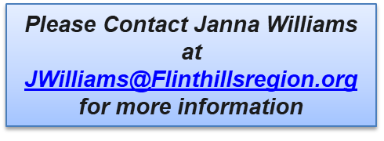
Brownfields Workshop in Council Grove
KDHE, EPA Region 7, KSU, FHRC

Slide 15
OLDCC Grant-Fort Riley Surrounding Communities
Current Projects for JLUS Boundary
Housing Studies
Cyber Assessment
Bridge Location/Alignment
Comprehensive Plan Plans
Municipalities/Counties
Riley, Geary, Clay & Pottawatomie County
MHK , Ogden, Riley
Junction City, Grandview Plaza
Milford, Wakefield, Clay Center
St. George, Green Valley
Schedule
Finalizing grant scopes/projects
Meet with Technical Committee
Submit Grant - August
Please Contact Janna Williams at JWilliams@Flinthillsregion.org for more information

Slide 16
5
OLD BUSINESS
b. CDGB Update
Holly Boice
CDBG award announcement: Alta Vista
Holly will attend administration workshop in McPherson Aug. 1.
2020 LMI data will likely be out by the end of the summer.
COVID Resiliency CDBG Program opportunity

Slide 17
5
OLD BUSINESS
Eligible activities for the program include COVID resiliency improvements for businesses such as:
Upgrades to remain open and prevent future closures due to community illnesses and public health emergencies.
Technology, hardware, and software upgrades.
E-commerce updates.
Professional development and training.
Other updates that can be directly related to resiliency improvements.

Slide 18
5
OLD BUSINESS
c. Executive Editor Search Update
Jerry Lonergan

Slide 19
6
COMMUNITY UPDATES
Geary County
Geary County – Trish Giordano
Junction City – Matthew Bea
Morris County
Council Grove – Sharon Haun
Morris County – David Fox
White City – Susan McKenzie
Pottawatomie County
Pottawatomie County – Dee McKee
Wamego – Richard Weixelman
St. George – Deb Werth
Onaga – Alex Miller
Westmoreland – Bruce Meninger
Wabaunsee County
Alma – Pam Bales
Wabaunsee County – Jim MacGregor
Alta Vista – Ryan Armbrust
Eskridge – Terry Cook
Harveyville – Teri Naylor
Ex-Officio
Fort Riley – Ben Van Becelaere,
Kelley Paskow
Gov. Military Council – Perry Wiggins
K-State – Cheryl Grice
Members in Non-Member Counties
Manhattan – Linda Morse
Ogden – Angela Schnee
Clay Center – James Thatcher
Wakefield – Julie Murphy
Herington – Debi Urbanek

Slide 20
MEETING ADJOURNED
NEXT MEETING
Aug. 18, 2023 – Manhattan
Flinthillsregion.org

