Slide 1


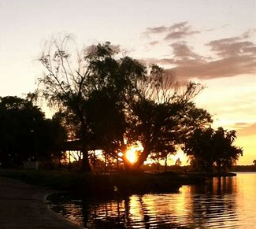
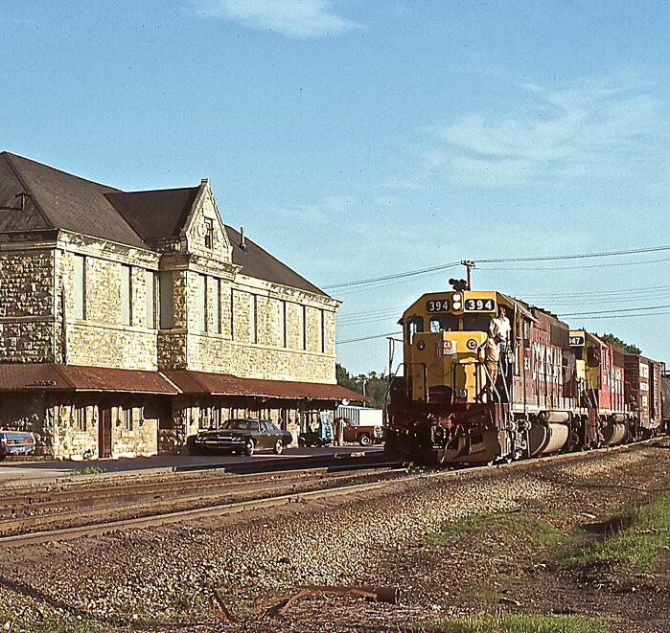
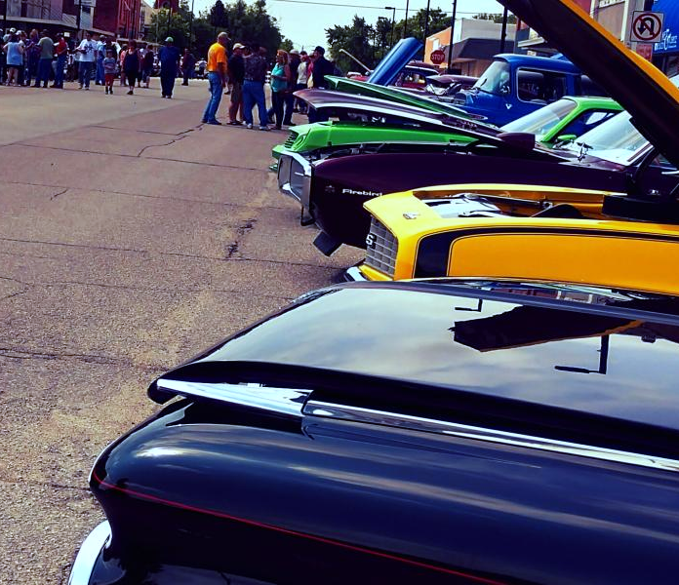
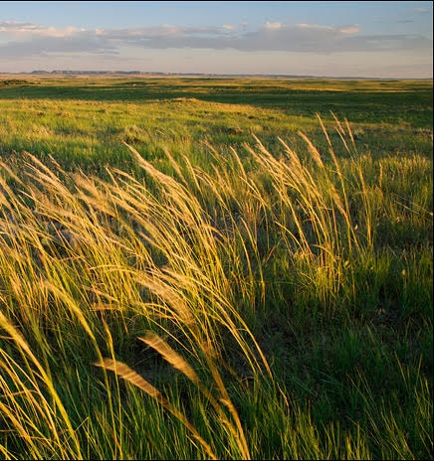


FLINT HILLS
REGIONAL COUNCIL
BOARD MEETING
Willie’s Hideout
St. George
June 16, 2023

Slide 2
AGENDA
1
2
3
4
5
6
7
CALL TO ORDER
WELCOME/ROLL CALL/QUORUM
APPROVAL OF MINUTES/FINANCIALS
NEW BUSINESS
OLD BUSINESS
COMMUNITY UPDATES
ADJORN

Slide 3
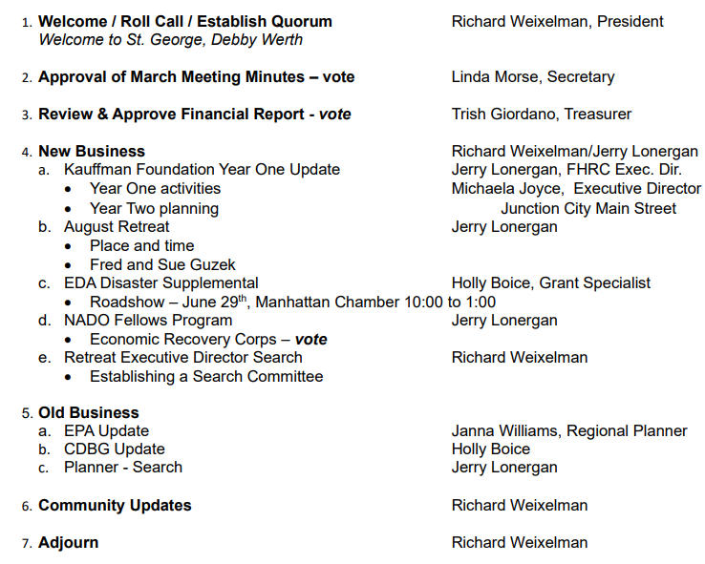
AGENDA

Slide 4

2
ROLL CALL
Clay County
Voting
1. Clay Center – James Thatcher
2. Wakefield – Julie Murphy
Dickinson County
Voting
1. Herington – Debi Urbanek
Geary County
Voting
1. Geary County – Trish Giordano
2. Junction City – Matthew Bea
Morris County
Voting
1. Council Grove – Sharon Haun
2. Morris County – David Fox
Non-Voting
White City – Susan McKenzie
Quorum (6)
Pottawatomie County
Voting
1. Pottawatomie County – Dee McKee
2. Wamego – Richard Weixelman
3. St. George – Deb Werth
Riley County
Voting
1. Manhattan – Linda Morse
Non-Voting
Ogden – Angela Schnee
Wabaunsee County
Voting
1. Alma – Pam Bales
2. Wabaunsee County – Jim MacGregor
3a. Alta Vista – Ryan Armbrust
3b. Eskridge – Terry Cook
3c. Harveyville – Teri Naylor
Ex-Officio
Non-Voting
Fort Riley
– Ben Van Becelaere
– Kelley Paskow
Gov. Military Council
– Perry Wiggins

Slide 5

3
MINUTES/FINANCIALS
Approval of May Minutes
Approval of April Financial Reports

Slide 6

3
ACCOUNTS
Bank Balance–Checking
  $26,282.90
Money Market
Dues Rec’d. ($109,885.50)
  $15,123.95
Kauffman Grant Account
& CDBG/NCRPC Funds
  $179,302.54
Community Foundation
  $20,698.00
CNB Loan Balance
  $18,821.21

Slide 7
3
BUDGET

Slide 8

4
NEW BUSINESS
a. Kauffman Foundation Year One Update
Jerry Lonergan and Michaela Joyce
Three Year Grant – Cooperative Project with Junction City Main Street. $120,000 a year for three years - $100,000 for programs and $20,000 for admin.
Year one activities
Year two planning

Slide 9
4
NEW BUSINESS
Home-Based Business Grant
One Year Report Submitted and Kauffman Approval for Year Two
First Year research on home-based businesses was presented at Council Grove February.
Michaela Joyce, JCMS, will review program activities today.
Kauffman has accepted the one-year report - $60,000 will be in account soon.

Slide 10
4
NEW BUSINESS
Home-Based Business Grant
Year Two Activities
Michaela Joyce will discuss
Microgrant “Proof of Concept” Pilot

Slide 11
4
NEW BUSINESS
b. August Retreat
Jerry Lonergan
Survey Results: 9 a.m. to 12 p.m. in Manhattan
Request was for an outside facilitator
Fred and Sue Guzek – KSU-Salina professors
Requesting only travel expenses
Visit with David Beurle regarding 5 Year plan
Focus will be developing implementation and action steps for the 5 Year plan

Slide 12
4
NEW BUSINESS
c. EDA Disaster Supplemental
Holly Boice
$57 Million across the EDA Denver Region – ten states
53 eligible counties in Kansas - most impacted in the Denver Region
Geary, Morris, Riley, Wabaunsee counties – windstorms and tornadoes in 2021 and 2022
FHRC counties’ population = 25% of the 53 counties total population
$5 million maximum ask - $1-2 million sweet spot
20% Match

Slide 13
4
NEW BUSINESS
Kansas Dept. of Commerce webinar – June 22
Roadshow: June 29 at Manhattan Chamber from 10-1.
    Overview by EDA
Q&A session
Consultation on project ideas
Variety of potential projects listed for EDA to pre-review for eligibility

Slide 14
4
NEW BUSINESS
d. NADO Fellows Program
Jerry Lonergan
National Association of Development Orgs. Economic Recovery Corps
65 early to mid-career professionals to be placed in selected orgs for 2.5 years, beginning January 2024
Salary and all ancillary expense paid by national consortium (FHRC will confirm this)
Must have specific activity for the Fellow to engage in
Proposals due June 30

Slide 15
4
NEW BUSINESS
FHRC will request a Fellow to:
Conduct feasibility, development business plan, assist with FHRC in preparing application for $500,000 to $1,000,000 to establish a revolving loan fund
Feasibility and Implementation of 5 Year Plan recommendation to create buying program for communities and matching regional suppliers with buyers

Slide 16
4
NEW BUSINESS
e. Executive Director Search
Job description

Slide 17

5
OLD BUSINESS
a. EPA Brownfield Assessment Project Update
Janna Williams

Slide 18


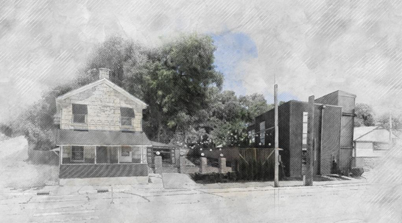
EPA Brownfield $500,000 Assessment Grant- Project Update
Ogden – 73,600/$119,100
5 Phase I Parcels
Downtown Area Planning (August Completion)
Area Wide Plan (arcgis.com)
Junction City – $122,000/162,000
11 Phase I Parcels
Area Planning (August completion)
Downtown Junction City (arcgis.com)
  Eskridge – $42,500/$66,700
  Phase I ESA’s – 9 completed FHRC (KDHE – 2)
  Reviewed with all owners
  Phase II’s, Structural Studies
      Market Study (due 6/30)
      Area Planning to begin after Market
  Manhattan– $84,700 budgeted
  MHK SoDo Area Planning kickoff $70,000 (Due 12/30)
  Catalyst Site- Phase I/II for MCM plant $10,000
  Phase I for Commercial Park at Airport $4,700
    EPA National Brownfield Conference in Detroit
    Poster Competition Entries (2)
Please Contact Janna Williams at JWilliams@Flinthillsregion.org for more information

Slide 19

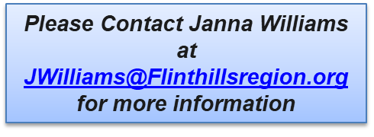
EPA Brownfield $1,000,000 Grant- 2024 *Communities in Red confirmed
Geary
Junction City
Milford
Clay
Wakefield
Riley
City of Riley
Ogden
Manhattan
Wabaunsee
Alta Vista, Paxico, Eskridge
Pottawatomie
Onaga
Westmoreland
Green Valley
Morris
Council Grove
Chase
Lyon

Slide 20
EPA – Greenhouse Gas Reduction Fund
Program Objectives: Reduce greenhouse gas emissions and other air pollutants to American communities, particularly low-income and disadvantaged communities. Mobilize financing and private capital to stimulate additional deployment of greenhouse gas and air pollution reducing projects.
1. National Clean Investment Fund $14 Billion: Fund 2-3 national nonprofits that will partner with private capital providers to deliver financing at scale to businesses, communities for clean technology projects.
2. Clean Communities Investment Accelerator $6 billion: Fund 2-7 hub nonprofits with the plans and capabilities to rapidly build the clean financing capacity of specific networks of public, quasi-public and non-profit community lenders to provide households, small businesses, schools, and community institutions in low-income and disadvantaged communities have access to financing for cost-saving and pollution-reducing clean technology projects.
3. Solar for All $7 Billion: Provide up to 60 grants to States, Tribal governments, municipalities, and nonprofits to expand the number of low-income and disadvantaged communities that are primed for investment in residential and community solar.
EPA asks potential applicants, coalition members, and partners identify their interest or project by June 18th. Those who provide their contact information will receive a list of all parties who are interested in discussing partnerships. Solar funds will be awarded to these coalitions and partnerships.
Please Contact Janna Williams at JWilliams@Flinthillsregion.org for more information

Slide 21



OLDCC Grant-Fort Riley Surrounding Communities
Current Projects for JLUS Boundary
Housing Studies
Cyber Assessment
Bridge Location/Alignment
Comp Plans
Municipalities/Counties
Riley, Geary, Clay & Pottawatomie County
MHK , Ogden, Riley
Junction City, Grandview Plaza
Milford, Wakefield, Clay Center
St. George, Green Valley
Schedule
Finalize grant scopes/projects
Meet with Technical Committee
Submit Grant - July
Please Contact Janna Williams at JWilliams@Flinthillsregion.org for more information

Slide 22
5
OLD BUSINESS
b. CDGB Update
Holly Boice
CDBG award announcement expected by early next month.
2020 LMI data will likely be out by the end of the summer.
COVID Resiliency CDBG Program opportunity

Slide 23
5
OLD BUSINESS
Eligible activities for the program include COVID resiliency improvements for businesses such as:
Upgrades to remain open and prevent future closures due to community illnesses and public health emergencies.
Technology, hardware, and software upgrades.
E-commerce updates.
Professional development and training.
Other updates that can be directly related to resiliency improvements.

Slide 24
5
OLD BUSINESS
c. Planner Search Update
Jerry Lonergan

Slide 25
6
COMMUNITY UPDATES
Geary County
Geary County – Trish Giordano
Junction City – Matthew Bea
Morris County
Council Grove – Sharon Haun
Morris County – David Fox
White City – Susan McKenzie
Pottawatomie County
Pottawatomie County – Dee McKee
Wamego – Richard Weixelman
St. George – Deb Werth
Onaga – Alex Miller
Westmoreland – Bruce Meninger
Wabaunsee County
Alma – Pam Bales
Wabaunsee County – Jim MacGregor
Alta Vista – Ryan Armbrust
Eskridge – Terry Cook
Harveyville – Teri Naylor
Ex-Officio
Fort Riley – Ben Van Becelaere,
Kelley Paskow
Gov. Military Council – Perry Wiggins
K-State – Cheryl Grice
Members in Non-Member Counties
Manhattan – Linda Morse
Ogden – Angela Schnee
Clay Center – James Thatcher
Wakefield – Julie Murphy
Herington – Debi Urbanek

Slide 26

MEETING ADJOURNED
NEXT MEETING
July 21, 2023 – Junction City
Flinthillsregion.org

