Slide 1
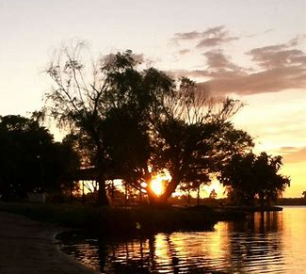
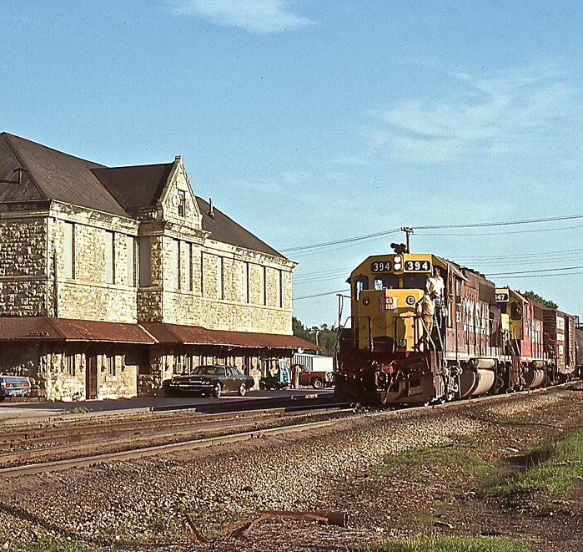
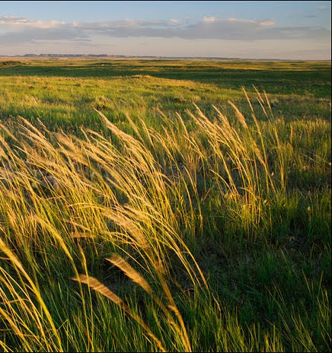
FLINT HILLS
REGIONAL COUNCIL
BOARD MEETING
Wabaunsee Co Fire District #5 Station
Eskridge
May 19, 2023

Slide 2
AGENDA
1
2
3
4
5
6
7
CALL TO ORDER
WELCOME/ROLL CALL/QUORUM
APPROVAL OF MINUTES/FINANCIALS
NEW BUSINESS
OLD BUSINESS
COMMUNITY UPDATES
ADJORN

Slide 3
2
ROLL CALL
Clay County
Voting
1. Clay Center – James Thatcher
2. Wakefield – Julie Murphy
Dickinson County
Voting
1. Herington – Debi Urbanek
Geary County
Voting
1. Geary County – Trish Giordano
2. Junction City – Matthew Bea
Morris County
Voting
1. Council Grove – Sharon Haun
2. Morris County – David Fox
Non-Voting
White City – Susan McKenzie
Quorum (6)
Pottawatomie County
Voting
1. Pottawatomie County – Dee McKee
2. Wamego – Richard Weixelman
3. St. George – Deb Werth
Riley County
Voting
1. Manhattan – Linda Morse
Non-Voting
Ogden – Angela Schnee
Wabaunsee County
Voting
1. Alma – Pam Bales
2. Wabaunsee County – Jim MacGregor
3a. Alta Vista – Ryan Armbrust
3b. Eskridge – Terry Cook
3c. Harveyville – Teri Naylor
Ex-Officio
Non-Voting
Fort Riley
– Ben Van Becelaere
– Kelley Paskow
Gov. Military Council
– Perry Wiggins

Slide 4
3
MINUTES/FINANCIALS
Approval of April Minutes
Approval of March Financial Reports

Slide 5
3
ACCOUNTS *As of 5/18
Bank Balance–Checking
$63,619.67
Money Market
Dues Rec’d. ($109,885.50)
$14,504.29
Kauffman Grant Account
& CDBG/NCRPC Funds
$183,740.20
CNB Loan Balance
$26,071.21

Slide 6
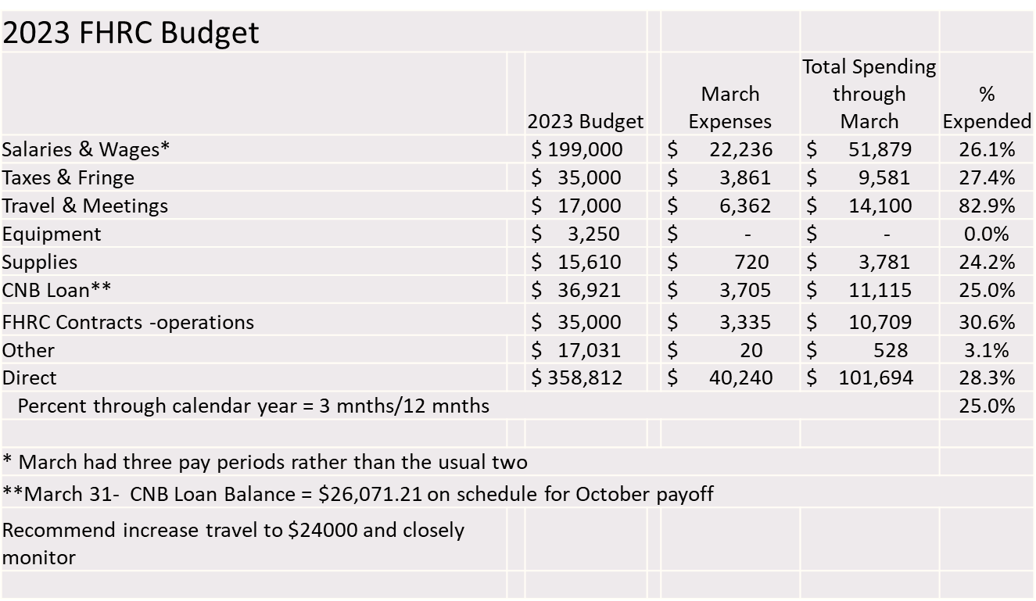
3
BUDGET

Slide 7
4
NEW BUSINESS
a. Five-Year Strategic Sustainability Plan
Review of board comments received and response
Vote to accept the plan
Staff to prioritize and recommend actions going forward (June meeting)

Slide 8
4
NEW BUSINESS
b. Update on EDA Disaster Grant Opportunity
Jerry Lonergan
c. Other Grant Possibilities
Jerry Lonergan
EDA Public Works and Economic Adjustment Assistance
EDA Planning and Local Assistance
KS Dept of Commerce – Request for Proposals to EDOs

Slide 9
Grants on the Horizon

Slide 10
EDA Disaster Supplemental Addressing economic challenges in areas with a declaration of a major disaster
$57 Million across the EDA Denver Region – ten states
53 eligible counties in Kansas
Kansas is most impacted in the Denver Region
Geary, Morris, Riley, Wabaunsee counties – windstorms and tornadoes in 2020 and 2021
FHRC counties’ population = 25% of the 53 counties total population
$5 Million maximum ask - $1-2 Million the sweet spot
20% Match

Slide 11
Next Steps
All FHRC members have been contacted
Development meetings are being scheduled
Early-June create one-page summaries
EDA will vet summaries to identity stronger projects
Mid-to-Late June EDA will have workshop, most likely in Manhattan
Goal is majority of proposals submitted end of July
FHRC staff role: convene, consult, conduit between EDA, write and revise proposals as capacity and staff time allows.

Slide 12
EDA Planning and Technical Assistance EDA Economic Adjustment Assistance
Annually EDA returns money to Federal Government from Planning and Technical Assistance pool
Planning and local technical assistance investments to support economic development, foster job creation, and attract private capital
FHRC will seek to identify projects that fit this opportunity (e.g., feasibility for creating a small business revolving loan fund)
Economic Adjustment – Closes July 1
Assists communities and regions in non-construction projects implementing and devising economic development ideas
FHRC needs to be prepared for this in 2024

Slide 13
KS Dept of Commerce – Request for Proposal
Release is expected mid-to-late June
$500,000 to $1,000,000
Funding for Regional Development Organizations
RDOs will be invited to compete for funds – best ideas win
Lt. Gov. seeks projects that actually “do” something
No planning or research is to be funded
RFP is still taking shape so some uncertainties remain, but FHRC will go aggressively for these funds. Disaster funding preparation will help identify projects for this RFP.

Slide 14
4
NEW BUSINESS
d. Board Retreat in August
Survey
Board Discussion

Slide 15
FHRC Member “Retreat Survey” – 10 Responses
Attend
4 - members, alternates only
3 - include invited guests
Meeting Purpose
6 – retreat, no regular meeting
4 - retreat with shorter meeting
Central Location
Manhattan mentioned most
Timing of Retreat
5 - Early morning, pastries coffee
4 - Midday with working lunch
Facilitated Meeting
4 - FHRC Staff Person
4 - Volunteer Facilitator
Suggested (one request each)
Matt Bea and/or Jerry Lonergan
Person with no direct FHRC connection
Topics – weighted avg.
10 - Prioritize Plan implementation
5 - Members’ Goals
3 - Expand Board Membership

Slide 16
5
OLD BUSINESS
a. EPA Brownfield Assessment Project Update
Janna Williams

Slide 17
5
OLD BUSINESS
EPA Brownfield $600,000 Assessment Grant- Project Update
Ogden – Area Planning $39,000/50,000 (August completion)
5 Phase I ESA sites
Downtown Planning continues. 2 new businesses joined.
Junction City – Area Planning $56,000/70,000 (August completion)
6+ Phase I ESA sites
Downtown Planning continues
Eskridge – $28,000
Phase I ESA’s complete for downtown corridor.
Begin review with property owners.
Market Study (ongoing) Area Planning- KSU TAB
Structural Study applications to begin
MHK/Riley County –
Airport Business Park – Phase I completed $6,000
MHK Area Planning started $70,000/value (December)
All remaining funds reserved for Phase II’s, Sampling, Outreach.
Project is on schedule.
Met with members regarding next EPA Brownfield Grant 2024: Westmoreland, Onaga, MHK, Ogden, Junction City, Alta Vista, Eskridge, (Wakefield, Council Grove, Morris County, St. George)

Slide 18
5
OLD BUSINESS
b. CDGB Update
Holly Boice
The Alta Vista CDBG application for the park project has been submitted to KDC for review. Reward announcement is expected in June.
Attending Eskridge City Meeting on Monday to present on CDBG opportunities.

Slide 19
6
COMMUNITY UPDATES
Geary County
Geary County – Trish Giordano
Junction City – Matthew Bea
Morris County
Council Grove – Sharon Haun
Morris County – David Fox
White City – Susan McKenzie
Pottawatomie County
Pottawatomie County – Dee McKee
Wamego – Richard Weixelman
St. George – Deb Werth
Wabaunsee County
Alma – Pam Bales
Wabaunsee County – Jim MacGregor
Alta Vista – Ryan Armbrust
Eskridge – Terry Cook
Harveyville – Teri Naylor
Ex-Officio
Fort Riley – Ben Van Becelaere,
Kelley Paskow
Gov. Military Council – Perry Wiggins
Members in Non-Member Counties
Manhattan – Linda Morse
Ogden – Angela Schnee
Clay Center – James Thatcher
Wakefield – Julie Murphy
Herington – Debi Urbanek

Slide 20
MEETING ADJOURNED
NEXT MEETING
June 16, 2023 – St. George
Flinthillsregion.org

