Slide 1


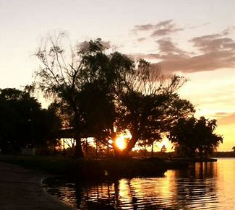
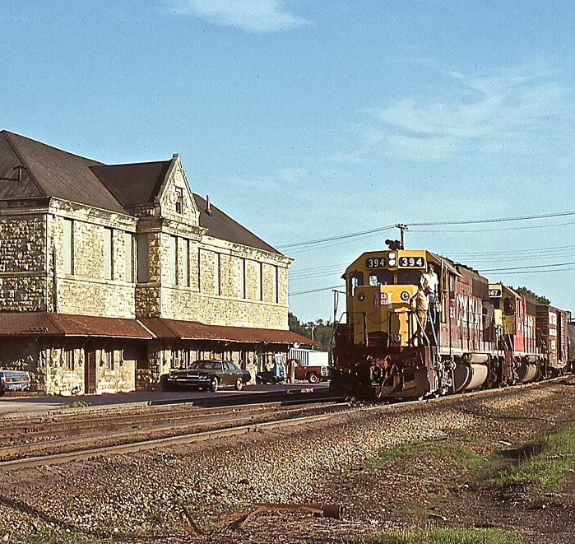
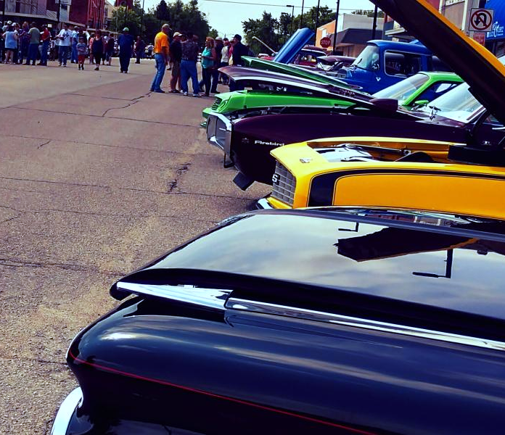
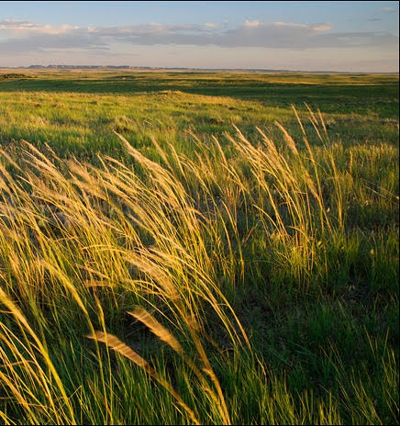



F H R C
F L I N T H I L L S R E G I O N A L C O U N C I L
B O A R D M E E T I N G
Ogden Community Center
Ogden
March 17, 2023

Slide 2
A G E N D A
1
2
3
4
5
6
7
8
CALL TO ORDER
WELCOME/ ROLL CALL/ QUORUM
APPROVAL OF MINUTES/ FINANCIALS
NEW BUSINESS
OLD BUSINESS
COMMUNITY UPDATES
ADJORN
THINK TANK SESSION

Slide 3
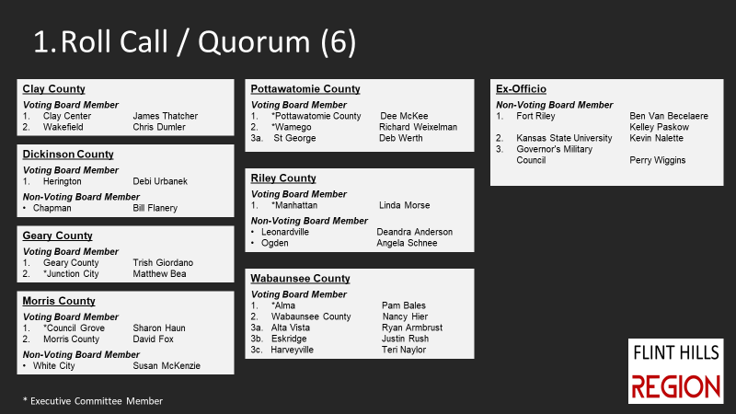
2
R O L L C A L L
1 2
3
4
5
6
7
Jim McGregor
Terry Cook
Terry Cook
Teresa Naylor

Slide 4
3 3
M I N U T E S / F I N A N C I A L S
Approval of February Minutes
Approval of February Financial Reports

Slide 5

M I N U T E S /F I N A N C I A L S
4 3
A C C O U N T S
Line of Credit
Bank Balance–Checking
  $47,796.66
Money Market
Dues Rec’d. ($109,885.50)
  $70,973.49
Kauffman Grant Account
& CDBG/NCRPC Funds
  $193,257.50
CNB Loan Balance
  $29,622.01

Slide 6
M I N U T E S /F I N A N C I A L S
4 3
A C C O U N T S
 |  | 2023 Budget |  | January Expenses | % Expended |  | Line-Item Location on Financial Statement all are on Page 2
Salaries & Wages |  | $ 199,000 |  | $ 14,822 | 7.4% |  | Total 6000 - Salaries and wages
Taxes & Fringe |  | $ 35,000 |  | $ 3,142 | 9.0% |  | Total 61000 - Payroll taxes & benefits
Travel & Meetings |  | $ 17,000 |  | $ 3,462 | 20.4% |  | Total 62000 - Travel and meeitngs
Equipment |  | $ 3,250 |  | $ - | 0.0% |  | Total 63000 - no line until Expenses recorded
Supplies |  | $ 15,610 |  | $ 2,904 | 18.6% |  | Total 65000 - Supplies
CNB Loan* |  | $ 36,921 |  | $ 3,705 | 10.0% |  | Page 1, 13000- CNB Loan
FHRC Contracts |  | $ 35,000 |  | $ 329 | 0.9% |  | 64003 Business Registration Fee
Other |  | $ 17,031 |  | $ 184 | 1.1% |  | 66000 Other Costs
Direct |  | $ 358,812 |  | $ 28,548 | 8.0%
1/12 through the Budget Year |  |  |  |  | 8.3%
*CNB Loan will be completed by October 2023

Slide 7

5 3
N E W B U S I N E S S
Nominating Committee Update
Matfield Green – Expression of Membership Interest
FHRC Grant Management Policy
Amending Current Bylaws Process
Flint Hills Region Data Presentation
    Interactive Map:
    https://www.google.com/maps/d/embed?mid=1tKwLuQuBXD0Vk0AjgL_tXVTqy1Aucv0&ehbc=2E312F

Slide 8
FHEDD Data Dive
Population
March 17, 2023

Slide 9
FHEDD Population Change Mirrors Kansas – Lags US – Pottawatomie Especially Strong
 |  |  |  | Percent Change
Area | 2010 | 2020 | 2021 | 2010 to 2020 | 2020 to 2021
Chase Co | 2,790 | 2,572 | 2,598 | -7.8% | 1.0%
Geary Co | 34,362 | 36,739 | 35,934 | 6.9% | -2.2%
Lyon Co | 33,690 | 32,179 | 31,998 | -4.5% | -0.6%
Morris Co | 5,923 | 5,386 | 5,356 | -9.1% | -0.6%
Pottawatomie Co | 21,604 | 25,348 | 25,790 | 17.3% | 1.7%
Riley Co | 71,115 | 71,959 | 72,208 | 1.2% | 0.3%
Wabaunsee Co | 7,053 | 6,877 | 6,966 | -2.5% | 1.3%
Flint Hills Regional Council | 176,537 | 181,060 | 180,850 | 2.6% | -0.1%
State of Kansas | 2,853,118 | 2,937,880 | 2,934,582 | 3.0% | -0.1%
United States | 308,745,538 | 331,449,281 | 331,893,745 | 7.4% | 0.1%

Slide 10
Johnson County Impacts Kansas Population
 | FHEDD | Johnson Co |  | KS | KS Not JO CO
2010 | 177,920 | 545,665 |  | 2,858,190 | 2,312,525
2020 | 181,044 | 610,536 |  | 2,935,880 | 2,325,344
Number Chg. 2010-2020 | 3,124 | 64,871 |  | 77,690 | 12,819
% Chg. | 1.76% | 11.89% |  | 2.72% | 0.55%
Without Johnson Co. the state’s population growth is barely 0.55%
FHEDD captures almost 1/3 of the growth in Kansas outside Johnson Co.

Slide 11
FHEDD Population is Younger than Kansas
Residents over 45 years represents 49.5% of Kansas Population
Over 45 years makes up just over 30% of FHEDD population
Military and College students impacts FHEDD
This only emphasizes the need of coordinated effort to keep those under 45 in the region

Slide 12
KU and WSU Demographers See Potential
After 2039 projections show sharp divergence between Kansas and FHEDD
By 2099 FHEDD has grown twice as fast as the state
Younger population staying and further abandonment of western Kansas rural areas.

Slide 13
5
O L D B U S I N E S S
a. EPA Brownfield Assessment Project Update
Stantec will be in the region next week for Area Plan meetings. All Phase I reports anticipated in 2 weeks.
Ogden – 3 sites, Steering Committee kickoff meeting in April
  Junction City – 6+ sites, Steering Committee Meeting Tuesday
  Eskridge - 12 sites for Phase I’s-due in two weeks
      Market Study and Planning proposed
  MHK/Riley County – Airport Business Park – Phase I submitted
  Project is on schedule and all funds committed.
b. American Defense Communities-DC
OLDCC Compatible Use Grant
Completion in April and closeout
OLDCC Sustainability Grant
One on Meetings week of 3/20
Completion in April
Approve and Adopt Grant Policy

Slide 14
5
O L D B U S I N E S
Anticipated 2023 CDBG Applications:
City/County | Project | Grant Category | National Objective | Amount Maximum | Deadline
Alta Vista | Park Equipment | Community Facilities | LMI: Area Benefit | $600,000 | May 1
Alta Vista | Historic Building Rehabilitation | Commercial Rehabilitation | Blight: Spot Basis | $250,000 | December 2
Council Grove | Historic Katy Depot Rehabilitation | Commercial Rehabilitation | Blight: Spot Basis | $250,000 | December 2
*Potential application for Commercial Rehabilitation in Matfield Green depending on city membership status.
Likely Future Applications:
City/County | Project | Grant Category | National Objective | Amount Maximum | Deadline
Wamego | Career Service Infrastructure | Youth Job Training | LMI: Limited Clientele | $100,000 | February 1
Eskridge | Housing Demolition and Rehabilitation | Housing | Blight: Spot Basis | $300,000 | December 2
Eskridge | Childcare Facility | Nonprofit Childcare and Education Facilities | LMI: Limited Clientele | $600,000 | February 1

Slide 16

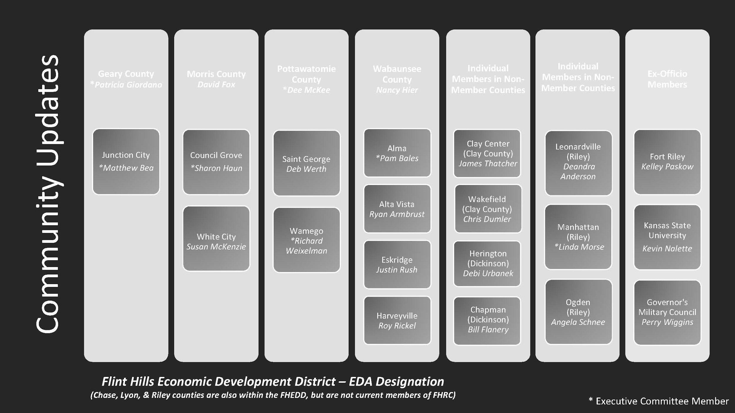
6 6
C O M M U N I T Y
updates
SAINT GEORGE
WAMEGO
POTTAWATOMIE COUNTY
WAKEFIELD
CLAY CENTER
OGDEN
MANHATTAN
GEARY COUNTY
JUNCTION CITY
CHAPMAN
ALMA
ESKRIDGE
ALTA VISTA
WABAUNSEE COUNTY
HARVEYVILLE
MORRIS COUNTY
COUNCIL GROVE
WHITE CITY
HERINGTON
K-STATE
FORT RILEY
Terry Cook
Teri Naylor

Slide 17
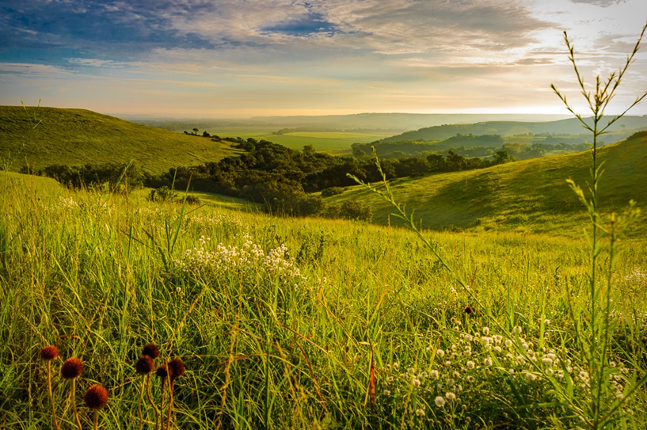

M E E T I N G A D J O U R N E D
N E X T M E E T I N G
TBD
Flinthillsregion.org

