Slide 1
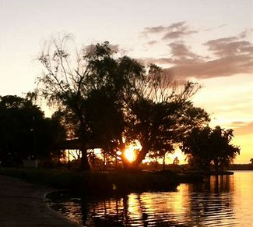
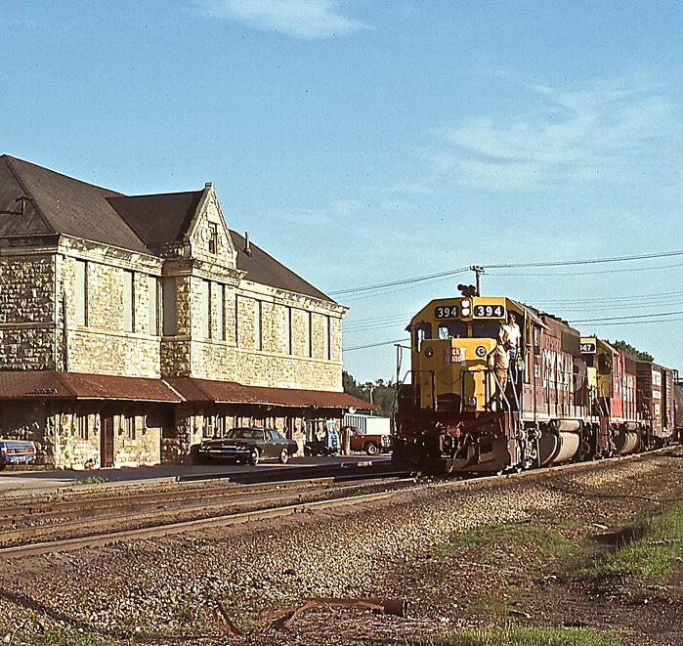
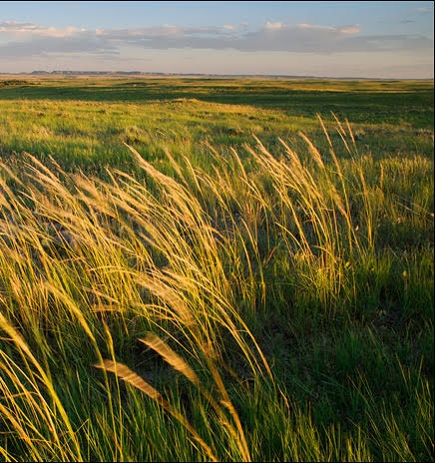
F H R C
F L I N T H I L L S R E G I O N A L C O U N C I L
B O A R D M E E T I N G
Wamego City Hall
Wamego
April 21, 2023

Slide 2
A G E N D A
1
2
3
4
5
6
7
CALL TO ORDER
WELCOME/ ROLL CALL/ QUORUM
APPROVAL OF MINUTES/ FINANCIALS
NEW BUSINESS
OLD BUSINESS
COMMUNITY UPDATES
ADJORN

Slide 3
2
R O L L C A L L
1 2
3
4
5
6
7
Jim McGregor
Terry Cook
Terry Cook
Teresa Naylor

Slide 4
3 3
M I N U T E S / F I N A N C I A L S
Approval of March Minutes
Approval of March Financial Reports

Slide 5
M I N U T E S /F I N A N C I A L S
4 3
A C C O U N T S
Line of Credit
Bank Balance–Checking
$5,504.80
Money Market
Dues Rec’d. ($109,885.50)
$1,257.10
Kauffman Grant Account
& CDBG/NCRPC Funds
$188,184.12
CNB Loan Balance
$29,622.01

Slide 6
M I N U T E S /F I N A N C I A L S
4 3
A C C O U N T S
Federal Grant
Reimbursement Requests
EPA
$171,083.74
OLDCC
$31,643.62
Total Reimbursement Requested
$202,727.36
Of the federal total, about $50,000 will go to FHRC, the balance to pay contracts.

Slide 7
5 3
N E W B U S I N E S S
Five-Year Sustainability Plan
David Beurle
Presentation link
(Vote on recommendations)

Slide 8
5 3
N E W B U S I N E S S
b. Vote to adopt Grant Management Policy
c. Process to amend current bylaws
d. Board Retreat in August - planning
e. EDA Denver Regional Meeting

Slide 9
O L D B U S I N E S S
EPA Brownfield Assessment - Project Update
Ogden – Area Planning $50,000
Stantec visit on April 13
5 Phase I ESA sites ( 2 new sites) $15,000
Steering Committee kickoff meeting
Design Workshop meeting with public
Ogden Open House #2 May 4
Junction City – Area Planning $70,000
6+ Phase I ESA sites $33,000
Downtown Planning continues
Public outreach event in May
Eskridge –
12 sites for Phase I sites $28,000
Market Study Kickoff and Area Planning- KSU TAB
MHK/Riley County –
Airport Business Park – Phase I submitted $6,000
Area Planning $70,000 estimate
All remaining funds reserved for Phase II’s and Outreach
Project is on schedule and all funds committed. 34% spent in 8 months
Next Steps…

Slide 10
5
O L D B U S I N E S S
b. CDBG update
Finishing up final details of the grant application for replacing park equipment and surfacing at the Alta Vista Community Park. Application is due May 1.
Vote to move forward with Alta Vista agreement for FHRC to administer CDBG funds for park project.

Slide 11
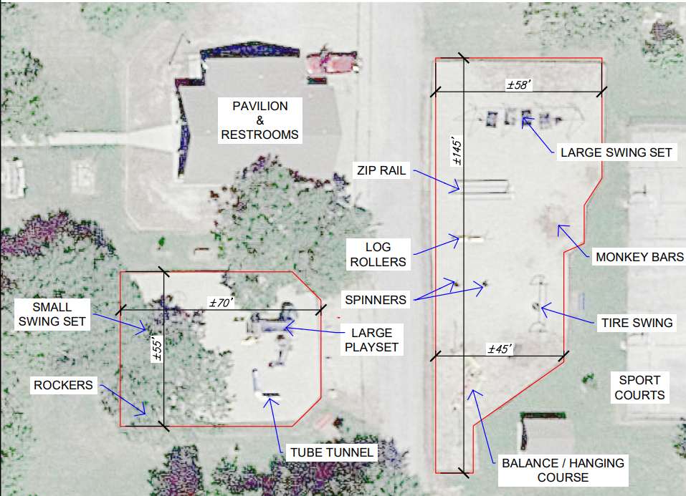

Slide 12
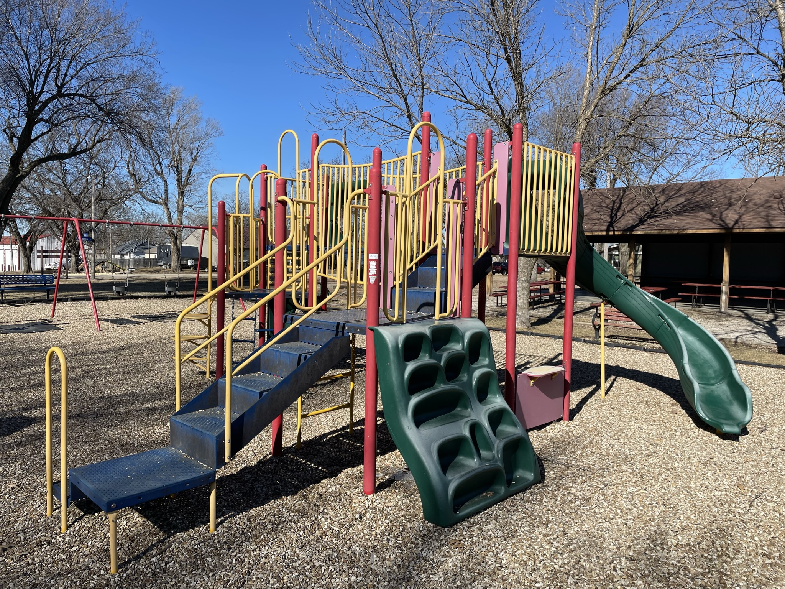

Slide 13
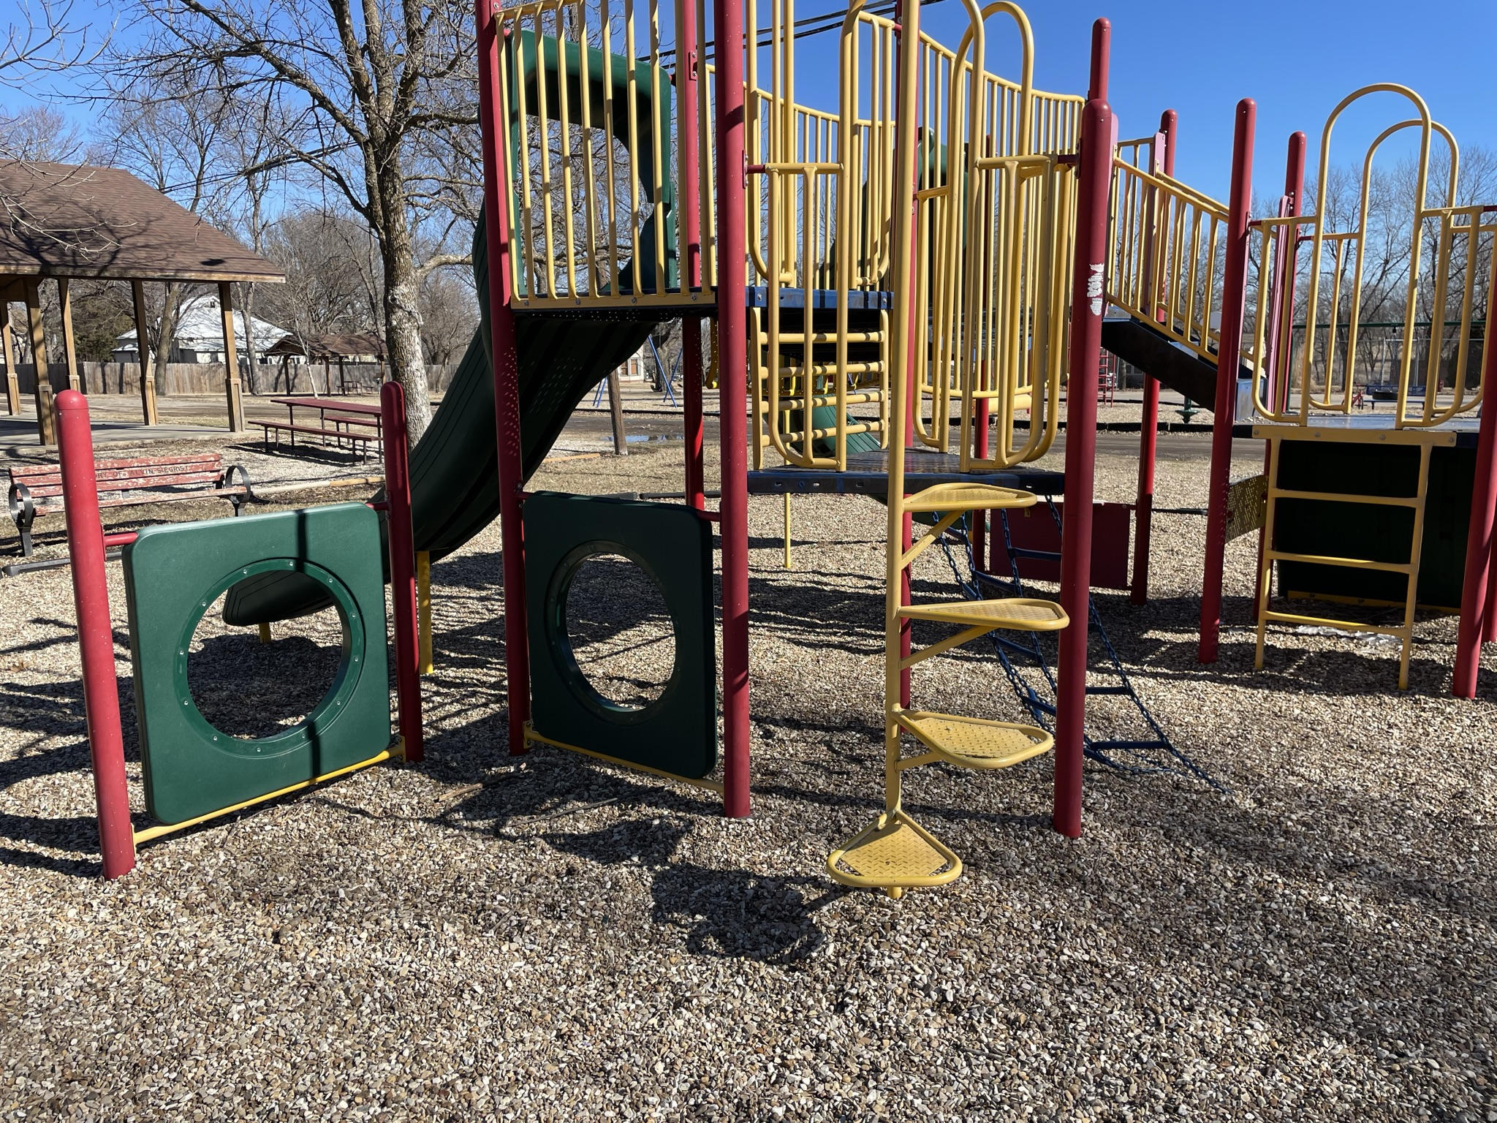

Slide 14
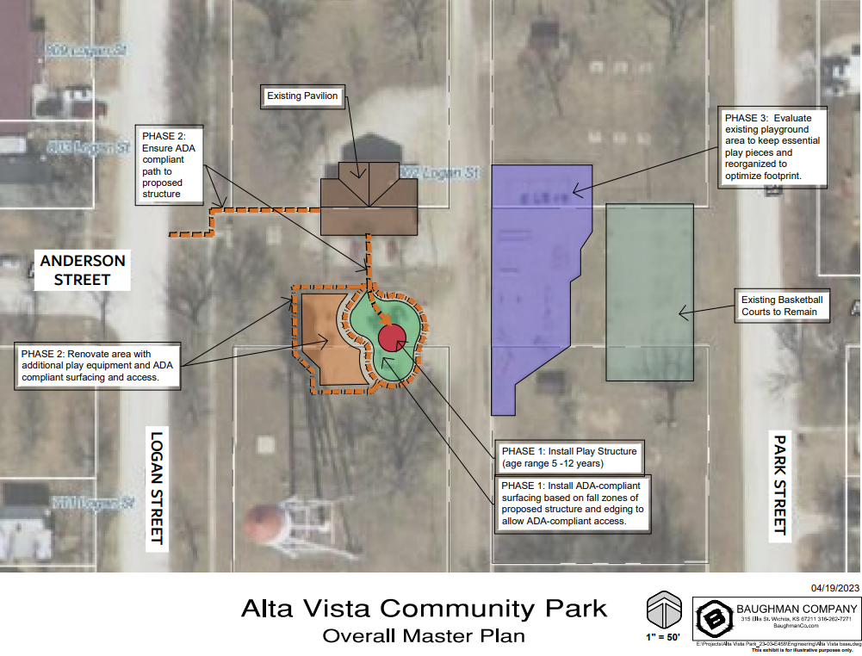

Slide 15
6 6
C O M M U N I T Y
updates
SAINT GEORGE
WAMEGO
POTTAWATOMIE COUNTY
WAKEFIELD
CLAY CENTER
OGDEN
MANHATTAN
GEARY COUNTY
JUNCTION CITY
CHAPMAN
ALMA
ESKRIDGE
ALTA VISTA
WABAUNSEE COUNTY
HARVEYVILLE
MORRIS COUNTY
COUNCIL GROVE
WHITE CITY
HERINGTON
K-STATE
FORT RILEY
Terry Cook
Teri Naylor

Slide 16
M E E T I N G A D J O U R N E D
N E X T M E E T I N G
TBD
Flinthillsregion.org

